Slide 1
CH 302 Exam 1 Review
09/17/18
Geoff Geberth

Slide 2
You need to know these equations!

Slide 3
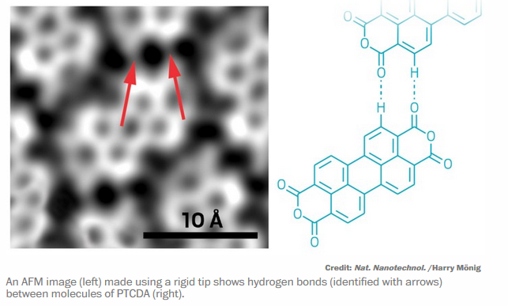
IMF’s (overview)
Dipole-dipole – forces between polar molecules
Dispersion forces – everything has them; strength hinges on polarizability (proportional to surface area)
Ion-dipole
H-bonding – extreme dipole-dipole: Hydrogen to a highly electronegative atom (N, O, or F)
stronger
Chemical & Engineering News, Vol 96, Issue 16

Slide 4
Enthalpy (H)
The heat at constant pressure (flow = ΔH)
Exothermic -> ΔH < 0
Energy flows from the system to the surroundings
Heat is given off (combustion)
Endothermic -> ΔH > 0
Energy flows to the system from the surroundings
Heat is absorbed (ice melting)
When predicting the sign, think where the energy is going
S < L < G

Slide 5
Entropy (S)
A measure of the dispersal of energy/the number of ways a system can be arranged
ΔS is a change in the dispersal of energy/number of microstates
S < L <<< G
Remember the 2nd Law: All spontaneous changes are accompanied by an increase in the entropy of the universe

Slide 6
Gibb’s Free Energy (G)
ΔG < 0 for spontaneous processes; > 0 for non-spontaneous
ΔG = 0 at equilibrium!
G = H – TS -> ΔG = ΔH – TΔS
Temperature can make a big difference in terms of spontaneity!
T can change whether the enthalpy term dominates or the entropy term dominates

Slide 7
Heating curves
Temperature does not change during phase changes!
Heating/cooiling: $q=m∗C_{s}∗∆T$
Phase change: $q=m∗∆H_{change}$
Remember: ΔH_{melt} = -ΔH_{fus} and ΔH_{cond} = -ΔH_{vap}
Phase changes
G
T
L
S
Heat Added

Slide 8
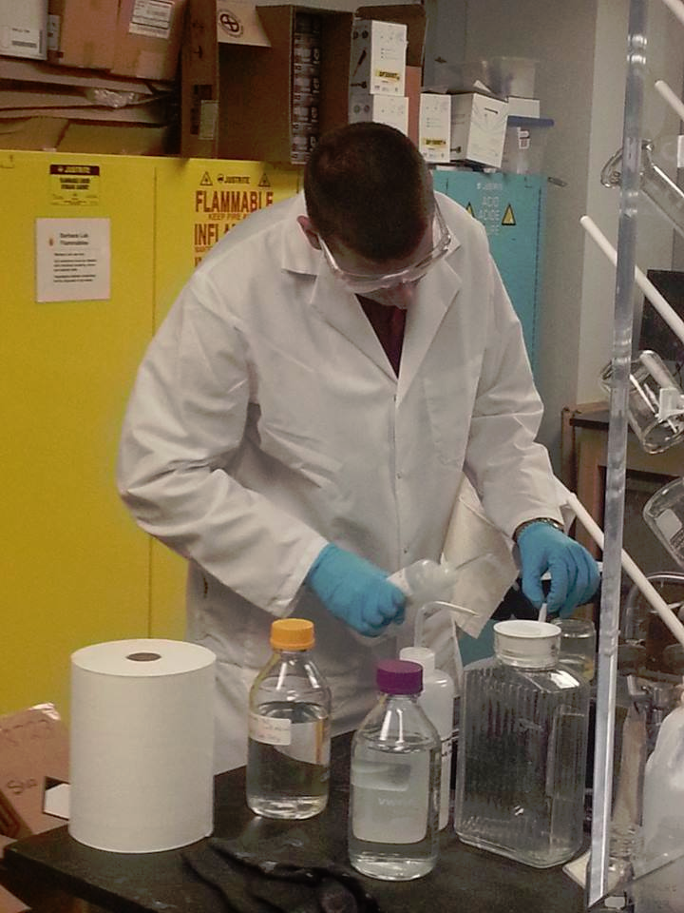
Example: The Ice Sculpture and the Hot Tub
Geoff was sitting in a hot tub (V = 1170 L) at 38⁰C thinking about thermodynamics at a wild party celebrating the win over USC, when someone unplugged it and threw in his 135 kg ice sculpture of Bevo! (kept at -15⁰C) Geoff immediately jumped out of the tub in surprise and began calculating whether or not he could get back in after the ice melted. What did he decide? (other than that the culprit should leave his party)
Where am I even going to find another sculpture!?

Slide 9
First, identify the starting points
Quantify the ice and water
$135 kg ice=135,000 g ∗\frac{1 mol}{18 g}=7500 mol ice$
$1170 L H_{2}O\left(l\right)∗\frac{1000 mL}{1L}∗\frac{1g}{1mL}∗\frac{1mol}{18g}=$65,000 mol liquid water
Warm the ice! (energy flows in)
$q=\left(135,000 g\right)∗\left(2.03\frac{J}{g∗℃}\right)∗\left(0−\left(−15\right)℃\right)=4110.75 kJ$
This energy came out of the warm water $q_{out of warm}=−q_{into ice}=−4110.75 kJ$
$C_{s,ice}=2.03\frac{J}{g∗℃};∆H_{fus}=6.01\frac{kJ}{mol}$; $C_{s,H_{2}O_{l}}=4.184\frac{J}{g∗℃}$
G
T
38⁰C
L
-15⁰C
S
Heat Added

Slide 10
Find new temp of the tub
$−4110750 J=1,170,000g H_{2}0\left(l\right)∗4.184\frac{J}{g∗℃ }∗∆T→∆T=−.8397=−.84℃→Water is now at 37.16℃$
Melt the ice!
$q_{into ice}=7500 mol ice∗6.01\frac{kJ}{mol}=45075 kJ=45,075,000 J$
Further cool the tub
$−45,075,000 J=1,170,000g H_{2}O \left(l\right)∗4.184\frac{J}{g∗℃}∗∆T→∆T=−9.2085℃→Water is now at 27.952℃$
$C_{s,ice}=2.03\frac{J}{g∗℃};∆H_{fus}=6.01\frac{kJ}{mol}$; $C_{s,H_{2}O_{l}}=4.184\frac{J}{g∗℃}$
G
T
38⁰C
L
-15⁰C
S
Heat Added

Slide 11
We now have 135,000 g of water at 0⁰C next to the rest of the tub at 27.952 ⁰C!
$q_{into cold}=−q_{out of warm}$
Algebra!
$135,000 g∗4.184\frac{J}{g∗℃}∗\left(T_{f}−0℃\right)=−1,170,000 g∗4.184\frac{J}{g∗℃}∗\left(T_{f}−27.952℃\right)$
$\left(T_{f}−0℃\right)=−\frac{1,170,000g}{135,000g}\left(T_{f}−27.952℃\right)$
$\left(T_{f}−0℃\right)=−8.667\left(T_{f}−27.952℃\right)$
$T_{f}=−8.667T_{f}+242.251℃$
$9.667T_{f}=242.251℃$
$→T_{f}=25.059℃≈77℉$
It’s more a swimming pool than a hot tub now!
But the unruly guests were still asked to leave
$C_{s,H_{2}O_{l}}=4.184\frac{J}{g∗℃}$
G
T
38⁰C
L
T_{f}
-15⁰C
S
Heat Added

Slide 12
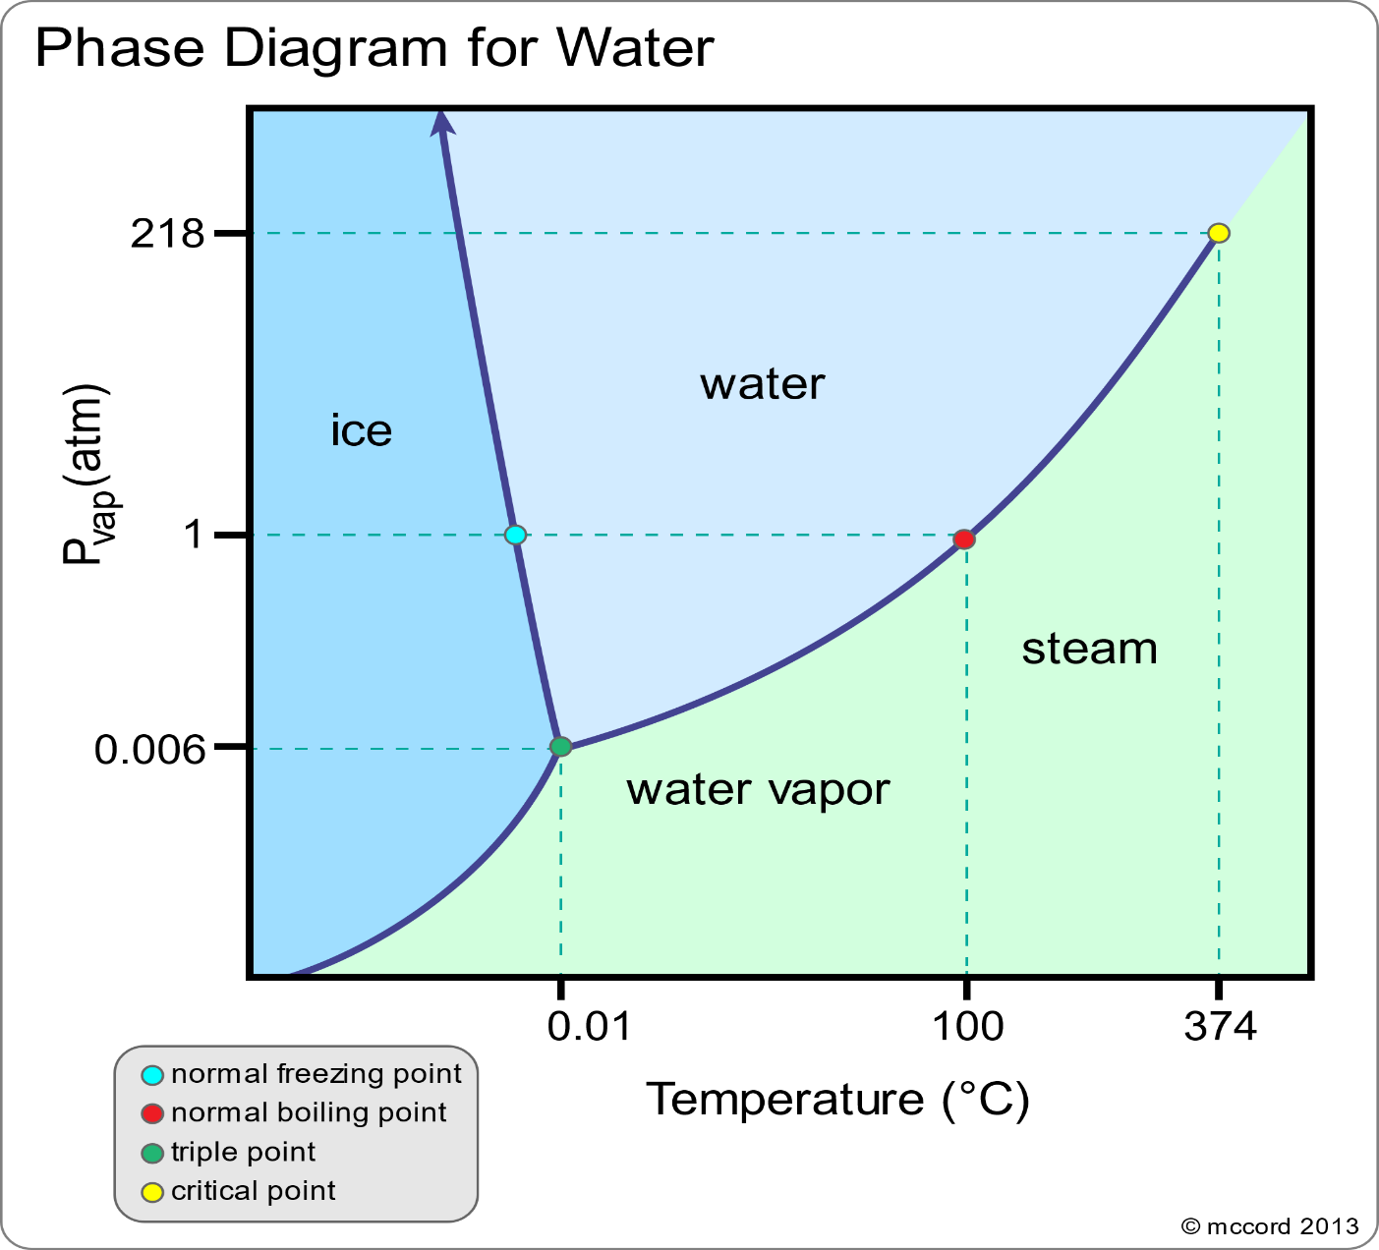
Phase diagrams
Shows most stable phase as a function of temperature and pressure
Standard phase transitions happen at 1 atm by definition
Several key points on the curve
Triple point
Supercritical region
Things other than water

Slide 13
Solutions
Enthalpy of solution
$∆H_{solution}=∆H_{lattice energy}+∆H_{solvation}$
$∆H_{solution}→the change in enthalpy on forming the solution$
$∆H_{lattice energy}→the energy required to pull a solute apart$
$∆H_{solvation}→the energy released when the solute interacts with the solvent$
Some notes about ΔH_{lattice energy}
only solids have a lattice energy by definition
This is the energy put in to over come solute-solute interactions (IMF’s)
More IMFs -> larger magnitude
>0! Remember, energy is going in

Slide 14
Will it Dissolve?
It’s all about ΔG!
$\left|T∆S_{solution}\right|>\left|{∆H}_{solution}\right|$
If you want to dissolve something:
Make sure the enthalpy term is small
Increase the temperature to enhance the entropic effects
When picking your solvent, look for similar IMFs to the solute
“Like dissolves like”
Similar IMFs reduces ΔH_{solution}

Slide 15
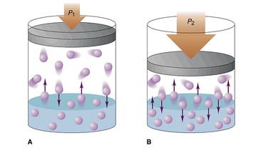
Henry’s law
The mole fraction of gas dissolved in liquid is directly proportional to the pressure of the gas over the liquid
$P_{gas}=KX_{gas}$
K depends on the IMFs between solvent and solute
This is how they carbonate soda

Slide 16
Colligative properties
Vapor Pressure
Partial pressure of a substance in equilibrium with its liquid phase
Decreases as IMFs increase
Increases with temperature (Clausius-Clapeyron Eqn)
Boiling Point Eleveation
Boiling point increases slightly in solutions
$∆T=iK_{b}m$ (POSITIVE NUMBER!!!)
Freezing Point Depression
Freezing point lowers slightly in solutions
$∆T=iK_{f}m$ (NEGATIVE NUMBER!!!)
A larger change than boiling point elevation
Osmotic Pressure
When a solution is formed, a pressure is generated and liquid flows through a semi-permeable membrane to restore equilibrium
$Π=iMRT$

Slide 17
Freezing Point Depression and Boiling Point Elevation
Intersections denote phase changes
Making a solution lowers free energy of the liquid
New phase change temperatures arise
G
L
G
S
solution
$$T_{m}$$
$$T_{m}^{°}$$
$$T_{B}^{°}$$
$$T_{B}$$
T

Slide 18
Van’t Hoff Factor (i)
The measure of how many pieces a substance breaks into when it dissolves
$i=\frac{m_{effective}}{m_{stated}}$
When 1 mol of a substance dissolves, how many moles of ions have I just produced?
Some materials do not break (non-electrolytes)
Glucose, enzymes, urea
Some materials readily fragment (strong electrolytes)
Think salts that make cations and anions
NaCl, KBr, RbF, etc.
Some materials only partially dissociate (weak electrolytes)
You can use the colligative property to determine the Van’t Hoff factor. Just work backwards from the change in the property and the pure solvent properties!

Slide 19
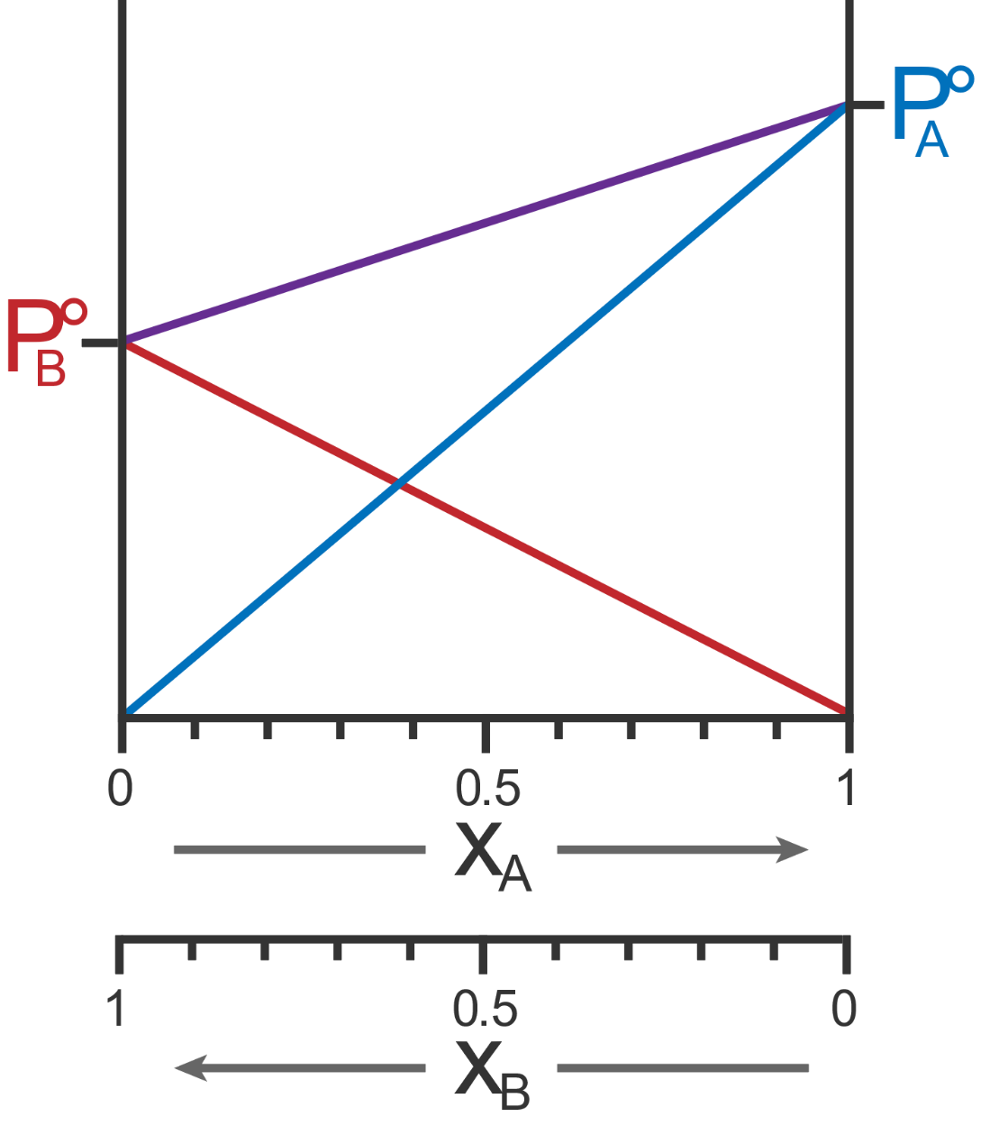
Vapor Pressure
Clausius-Clapeyron eqn helps dictate temperature dependence
$\ln\left(\frac{P_{2}}{P_{1}}\right)=\frac{{∆H}_{vap}}{R}\left(\frac{1}{T_{1}}−\frac{1}{T_{2}}\right)$
Vapor pressure in solution lowered due to an increase in entropy, thus lowering the free energy
New vapor pressure given by Raoult’s Law: $P_{sln}=χ_{solvent}P^{°}$
In a 2 liquid solution, Raoult’s law becomes: $P_{sln}=χ_{A}P_{A}^{°}+χ_{B}P_{B}^{°}$
Figure taken from gchem

Slide 20
Vapor Pressure
1.5 atm
Given the figure on the right, if I mix together compounds A and B such that I have .25 mol A and .75 mol B, what are the partial pressures of A and B, as well as the total pressure?
$P_{A}=.375 atm;P_{B}=.75 atm;$
$$P_{tot}=1.125 atm$$
1 atm
.5 atm
Figure taken from gchem

Slide 21
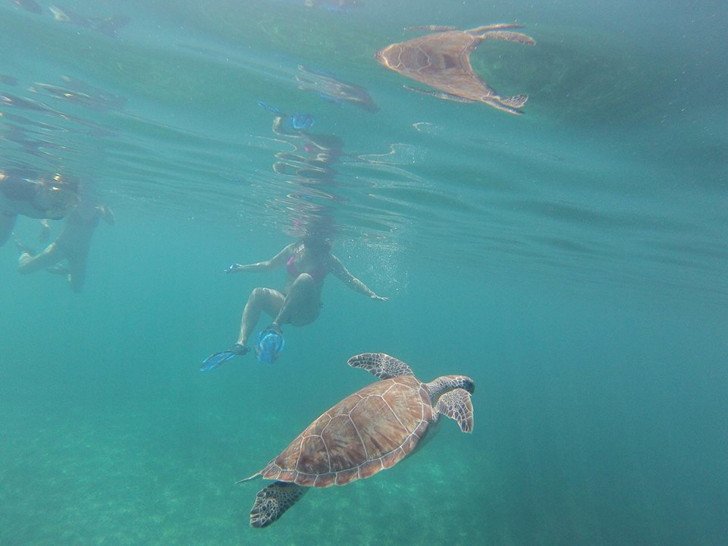
An Osmotic Pressure Problem
If I have a solution that is .6 M of NaCl in water, what is the osmotic pressure at 300K?
$Π=iMRT$
NaCl has a VHF of 2
$Π=\left(2\right)\left(.6\frac{mol}{L}\right)\left(.0821 \frac{L∗atm}{mol∗K}\right)\left(300 K\right)$
$≈30 atm!$ That’s a lot of pressure!
You just calculated how much pressure it takes to
desalinate seawater using reverse osmosis!

Slide 22
General tips
Write out your units on everything!
Write them, cross them out as they cancel. Do they make sense?
Ask yourself: does this answer make sense in terms of reality?
Think where energy is coming from or going to. Thermodynamics is all about the energy!
Write out your units on everything!
It’s so important I put it again

